Slide 1
Task 1
Internship Studio’s Ethical Hacking Internship
Name : Shantanu Ingle E-mail: shan.007g@gmail.com Contact no.: 7057546576

Slide 2
PortSwigger lab’s
snapshots in next few slides showing the completion of
task 1

Slide 3
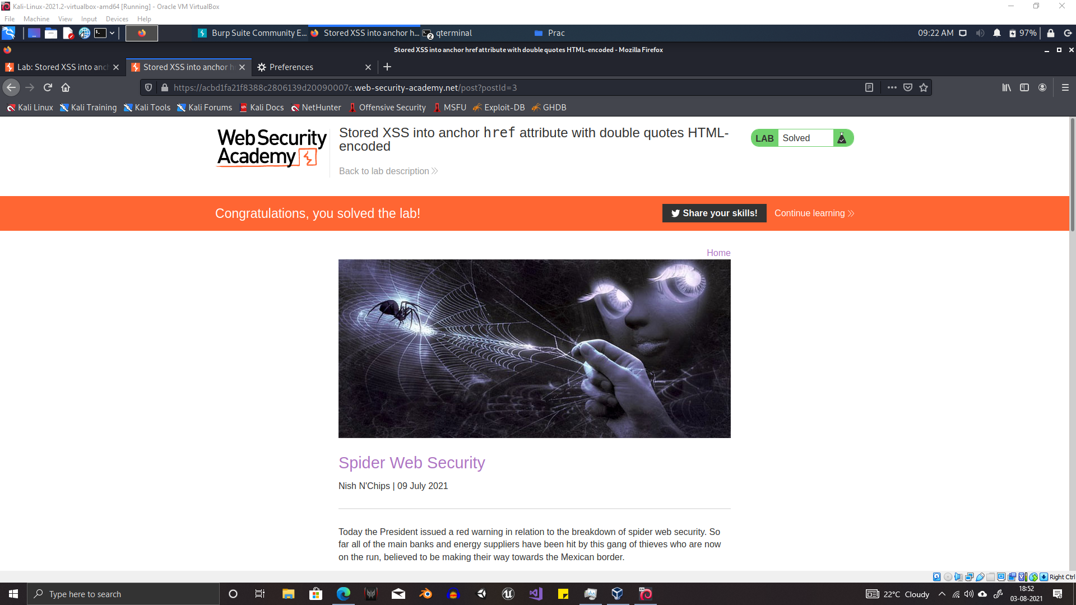

Slide 4
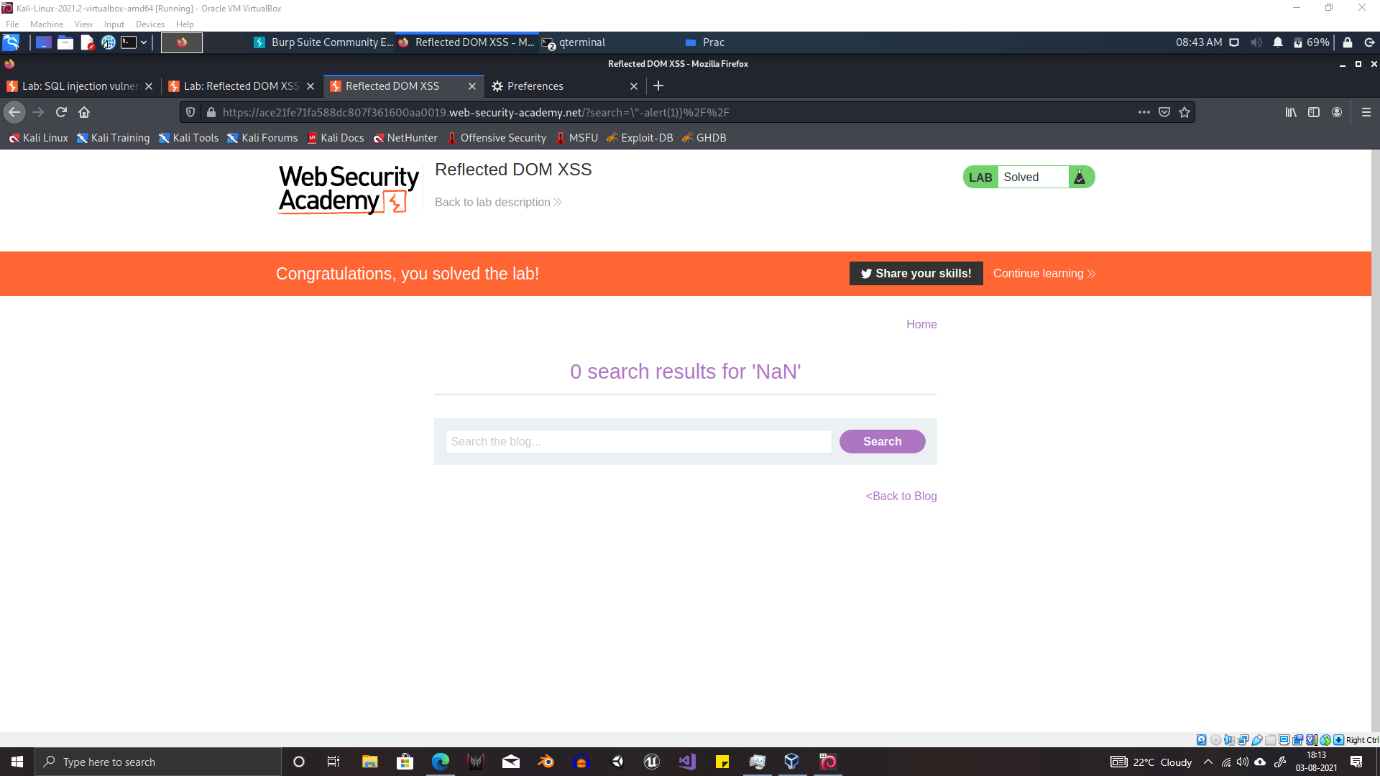

Slide 5
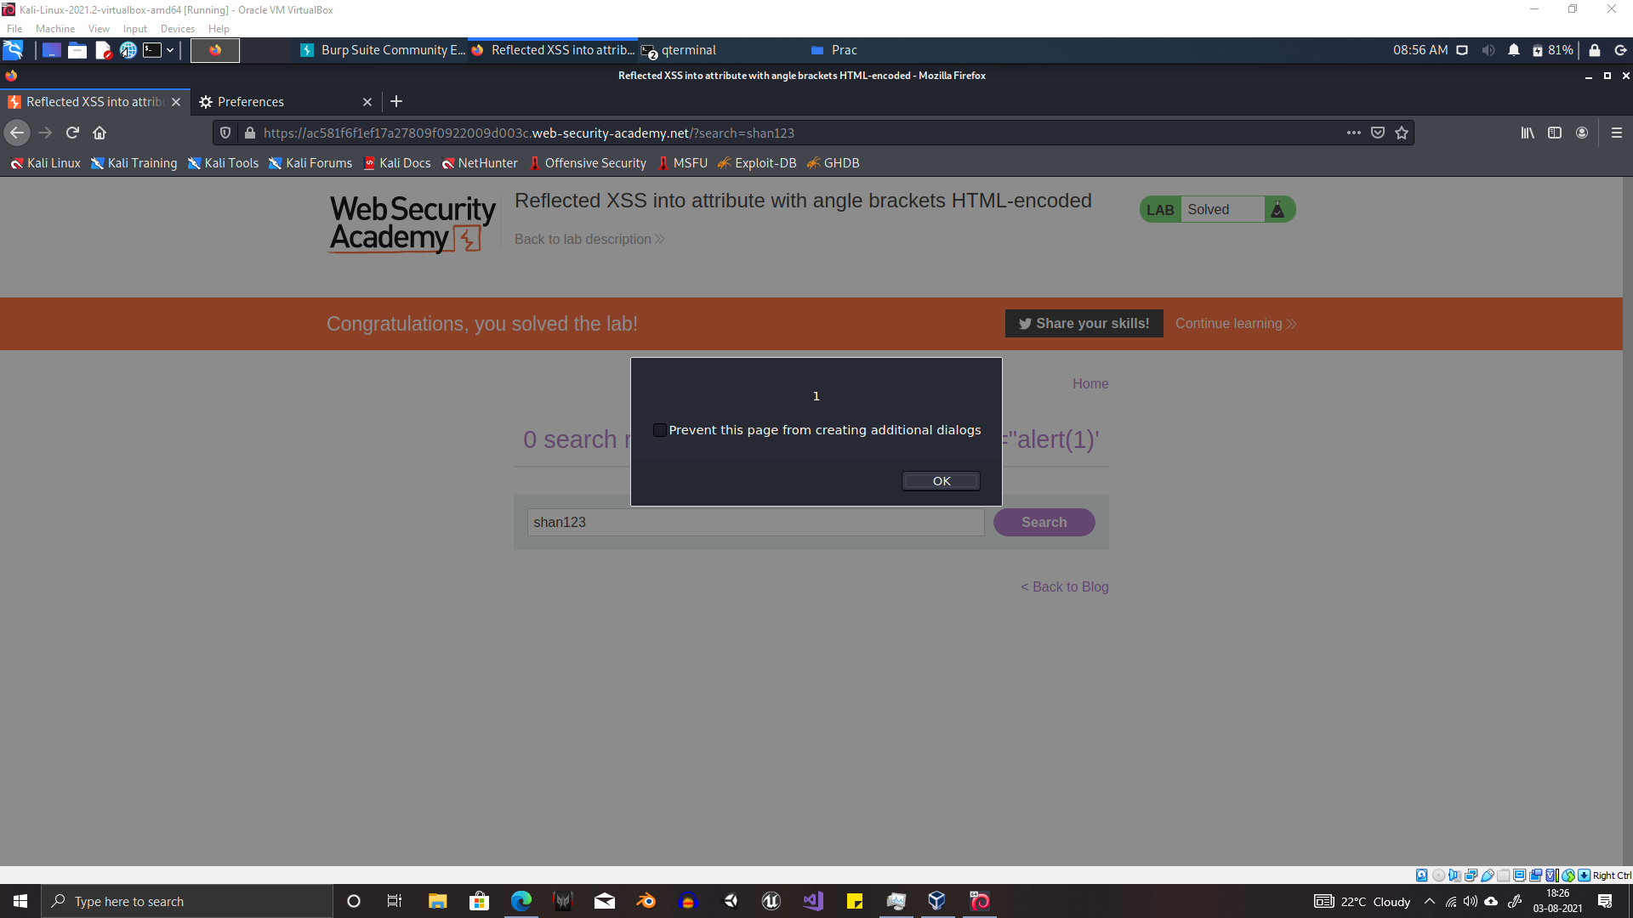

Slide 6
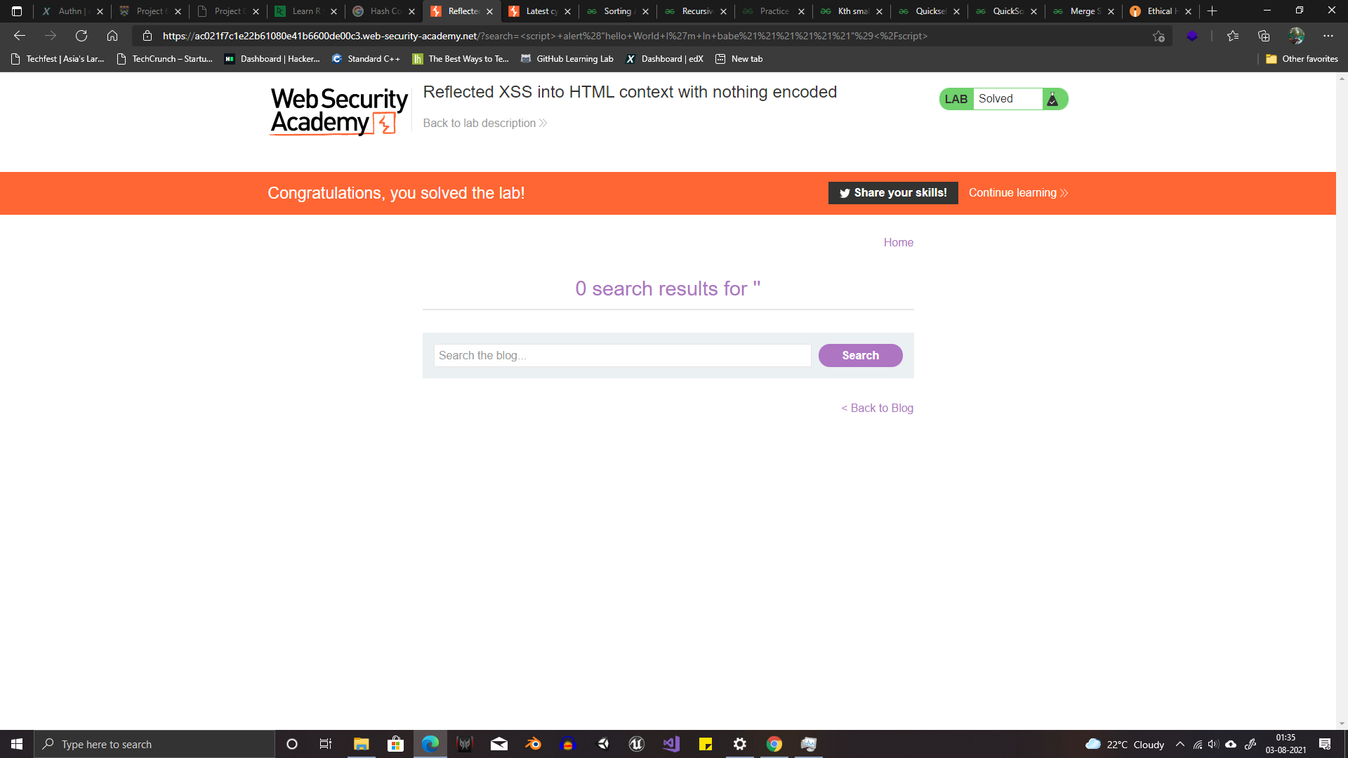

Slide 7
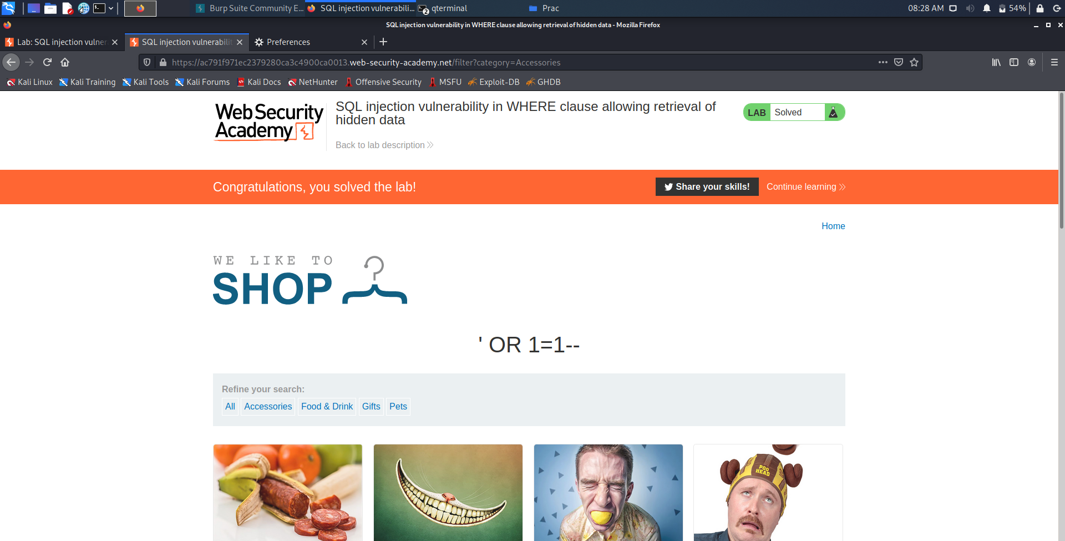

Slide 8
Thank You

